Slide 1

Stayin’ Alive: Predicting Shelter in Place Orders Using Twitter Sentiment Analysis
Advisor: Dr. Scott Cook
Suzie Tovar

Slide 2
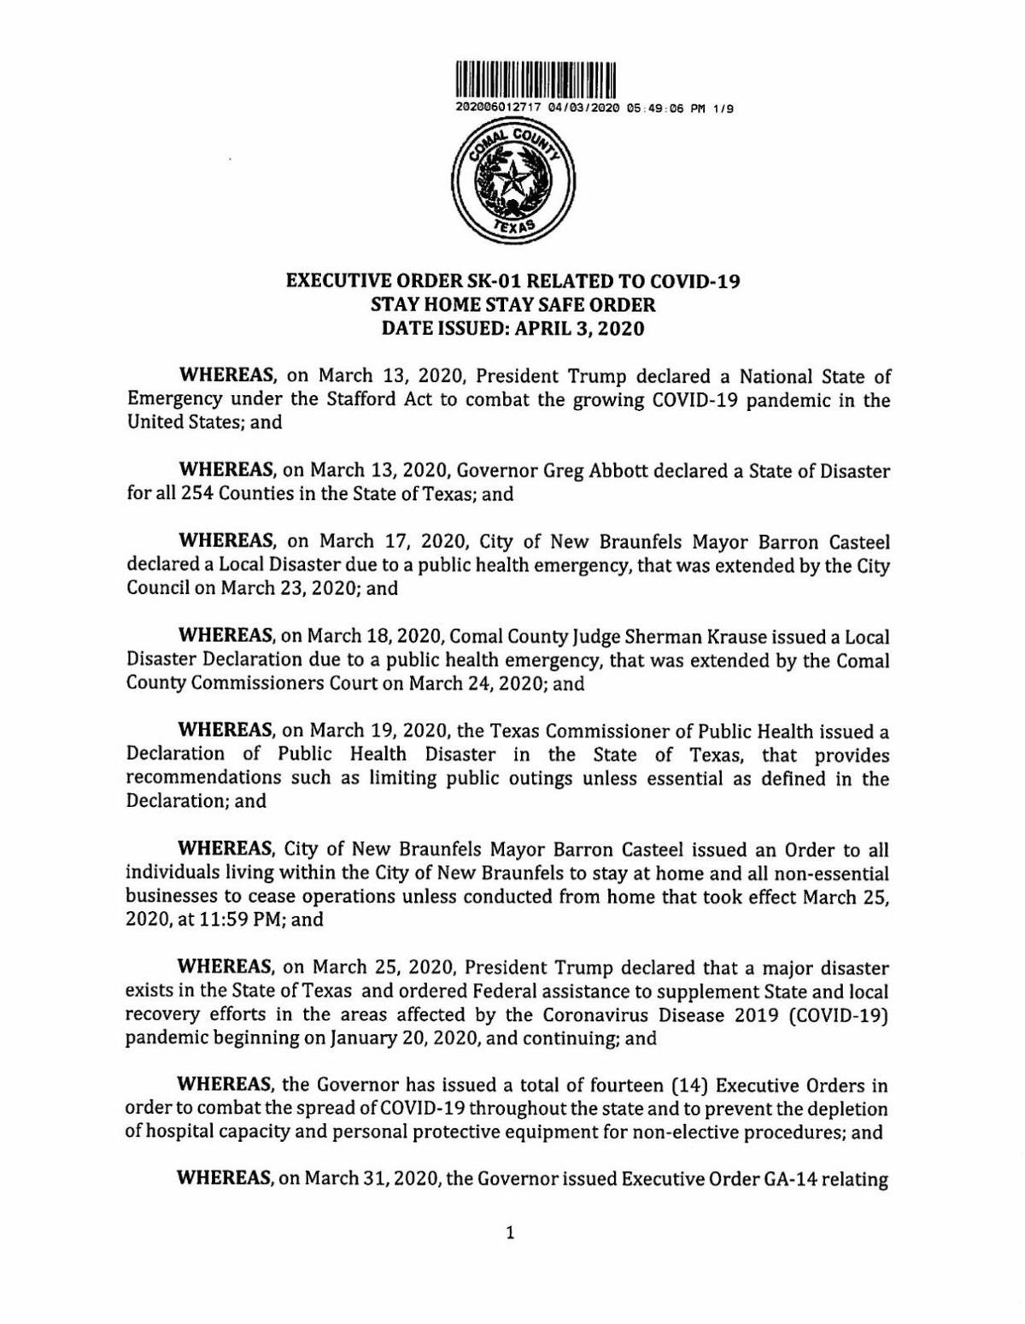
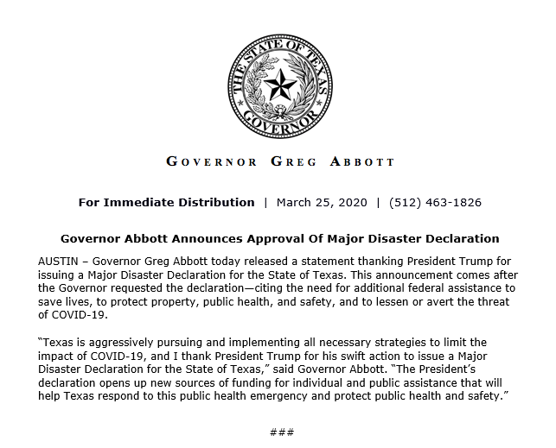
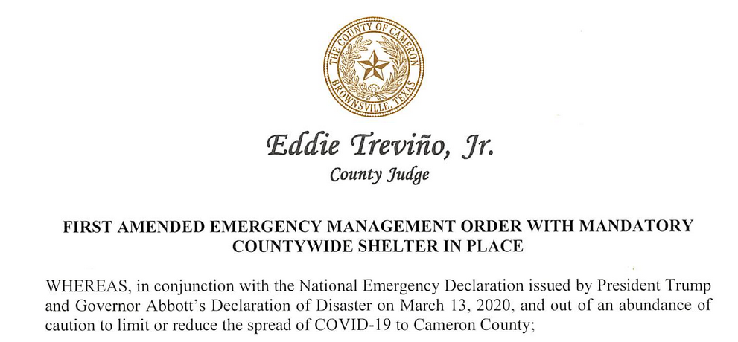
Coronavirus: Governor Executive Orders

Slide 3
Lightgbm Model Creation
Data Sampler
Goal: Randomly sample dataset with replacement.
Need to randomly sample from dataset because cities can be part of multiple counties.This is due to limitations when scraping data.
Cross Validation
For cross validation i performed k-fold.
04
04
01
01
03
03
Sample Aggregation
Created a matrix in order to have a model that predicts order on a day to day basis. Each row in the matrix representa the status of a county on a day.
Hyperparameter Tuning
Used sklearn to perform a gridsearch for the following parameters:
Number of leafs
Number of estimators
Learning rate
02
02

Slide 4
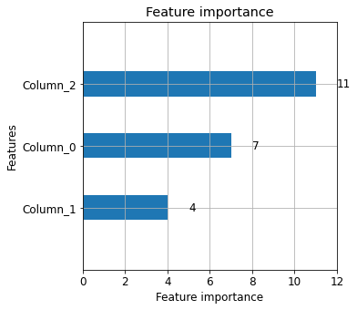
Feature Importance
Best Model Accuracy Score: 0.9725
Column_0 = cummulative_polarity
Column_1 = cummulative_subjectivity
Column_2 = disaster_declaration

Slide 5
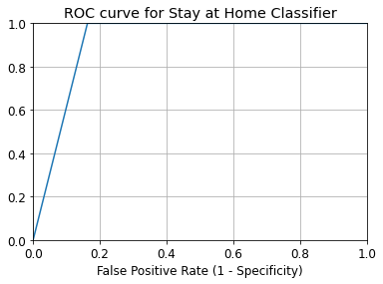
ROC Curve for Stay at Home Classifier

Slide 6
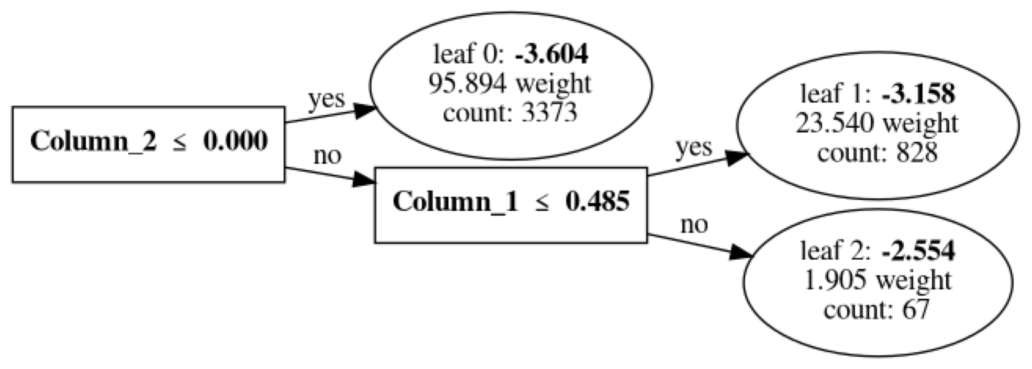
Lightgbm Tree

Slide 7


